Slide 1





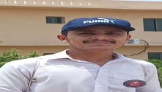

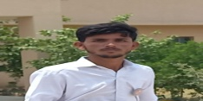

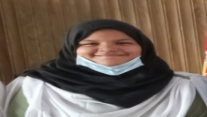


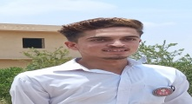
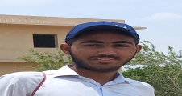






FC PUBLIC SCHOOL & COLLEGE,
Kohlu- Balochistan
Name: Adnan Khan
F. Name: Badsha Hussain
Class: X
Marks obtained: 1100/1065
Percentage: 96.82 %
Federal board of intermediate education Islamabad

Slide 2

FC PUBLIC SCHOOL & COLLEGE,
Sibi-Balochistan
Name: Khadija Jamali
F. Name: Raja Khan
Class: X
Marks obtained: 1100/922
Percentage: 83.81 %
Federal board of intermediate education Islamabad

Slide 3

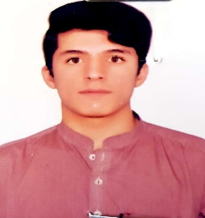
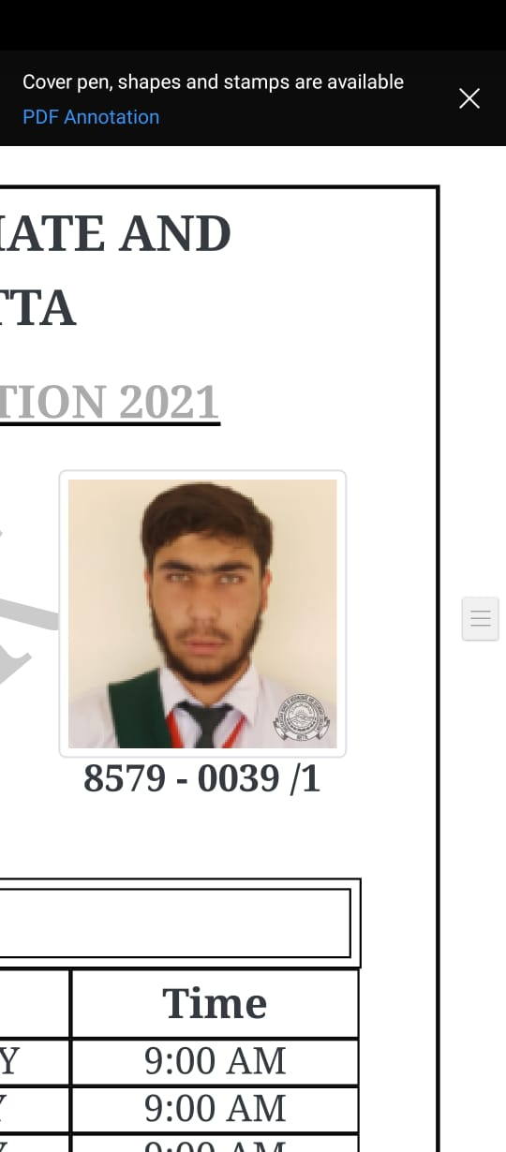
FC PUBLIC SCHOOL & COLLEGE,
Beleli-Balochistan
Name: Attiq Ullah
F. Name: Nil
Class: X
Marks obtained: 1050/870
Percentage: 82.86 %
Federal board of intermediate education Islamabad

Slide 4

FC PUBLIC SCHOOL & COLLEGE,
Loralai-Balochistan
Name: Syed Tanees Fatima
F. Name: Nil
Class: X
Marks obtained: 1050/1029
Percentage: 93.55 %
Federal board of intermediate education Islamabad

